Slide 1
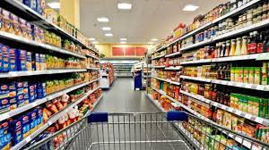
Big Mart Sales Prediction

Slide 2
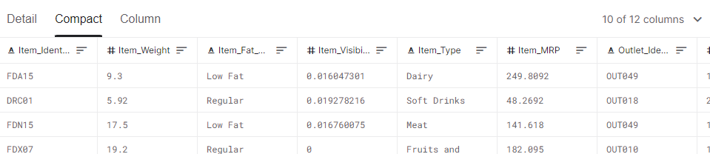
Big Mart is a big supermarket that sales different products across stores in different cities.
The dataset was taken from Kaggle website (BigMart Sales Data | Kaggle).
The dataset contains 8523 entries and 12 features
Notes:
Consider talking about:
Online-only supermarkets (21st century)

Slide 3
From Big Mart dataset I am going to:
analyze customer behavior
understand the properties of products and stores which play a key role in increasing sales.
My goal is to create a model that can predict the sales per product for each store .

Slide 4
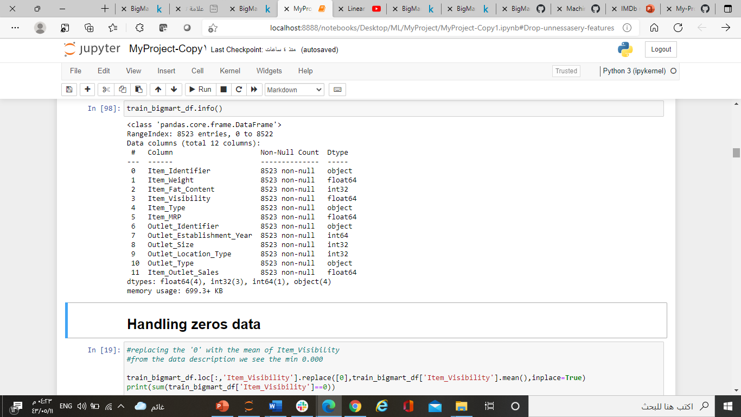
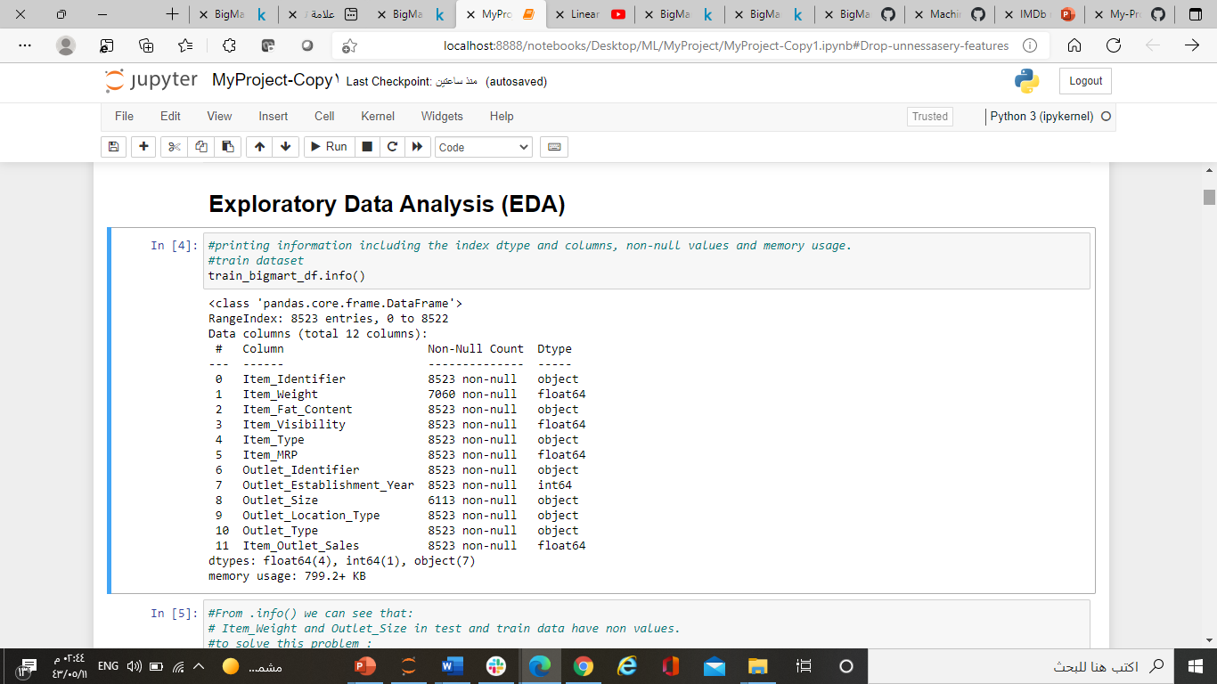
Before Analyzing and exploring the data I do the following:

Slide 5
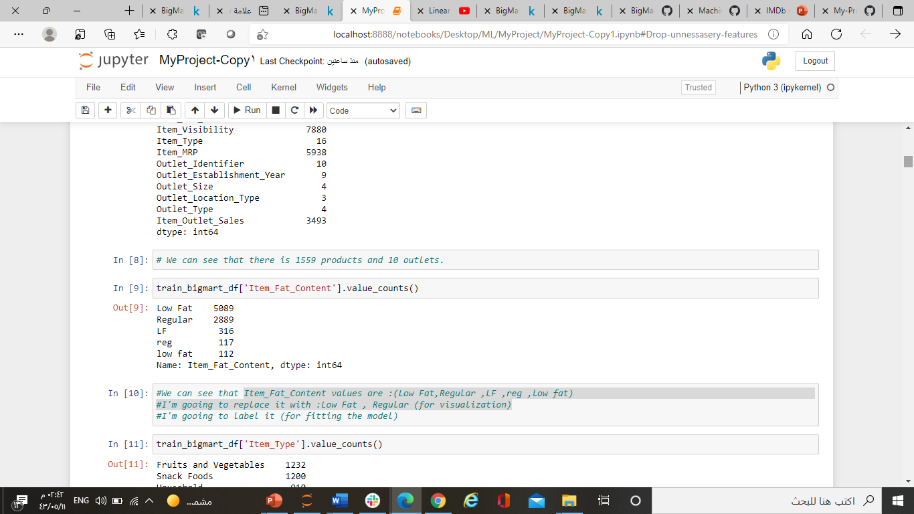
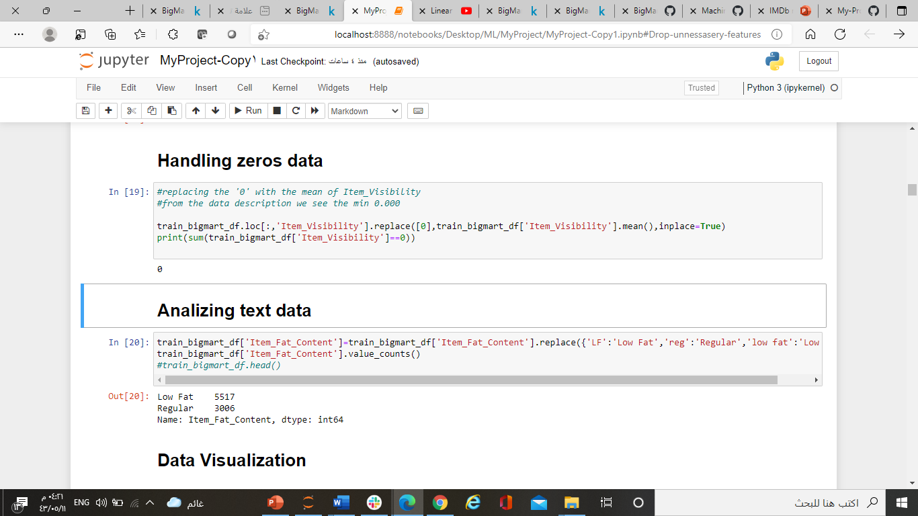
Before Analyzing and exploring the data I do the following:

Slide 6
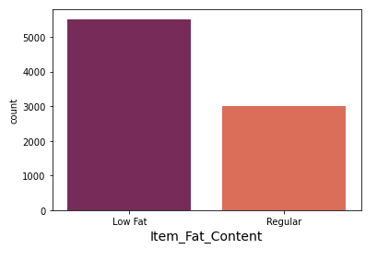
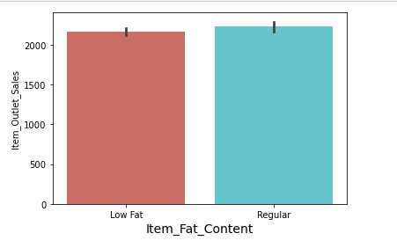
From analyzing and exploring the data I answer some questions such as:
Which product people bought more low fat or regular fat?
Which product have more profitable the low fat or regular fat?

Slide 7
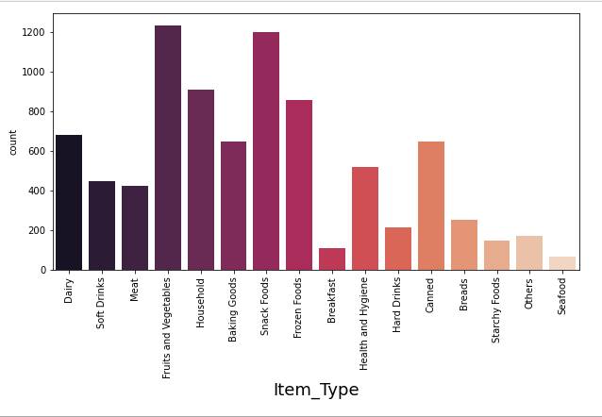
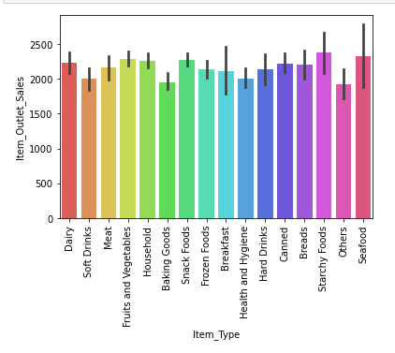
- What kind of product people bought more?
- What product have most profit?

Slide 8
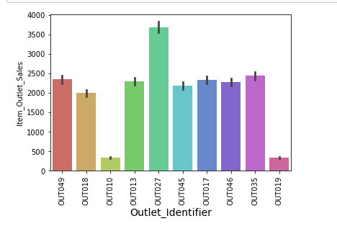
- Which outlet have the top sales?

Slide 9
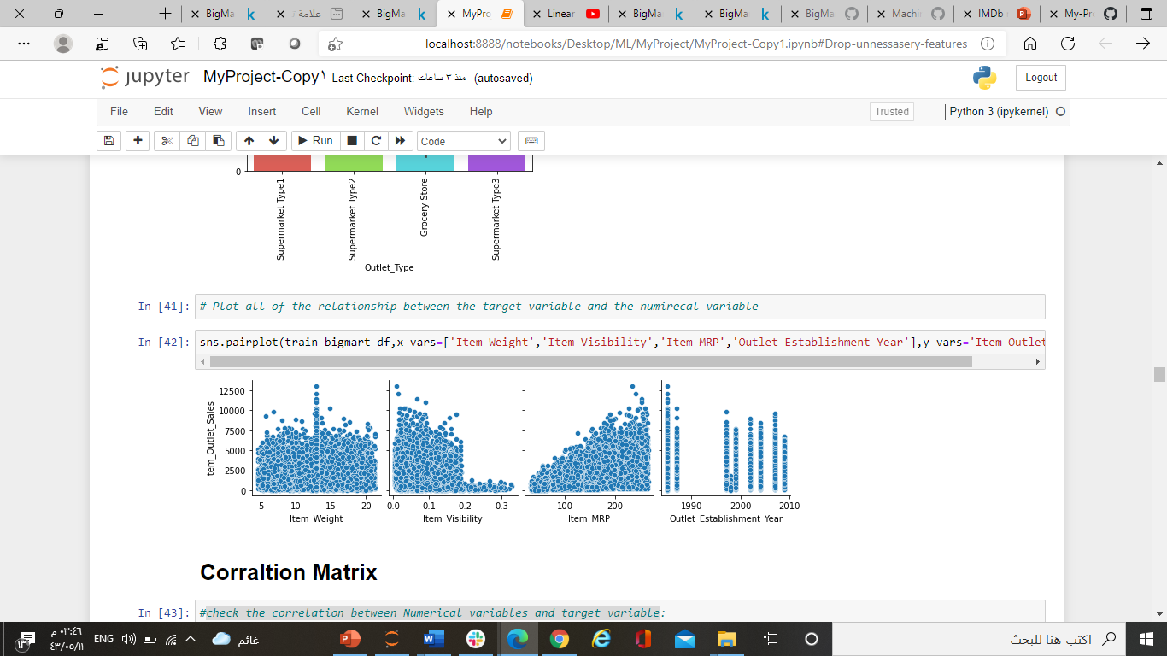

Slide 10
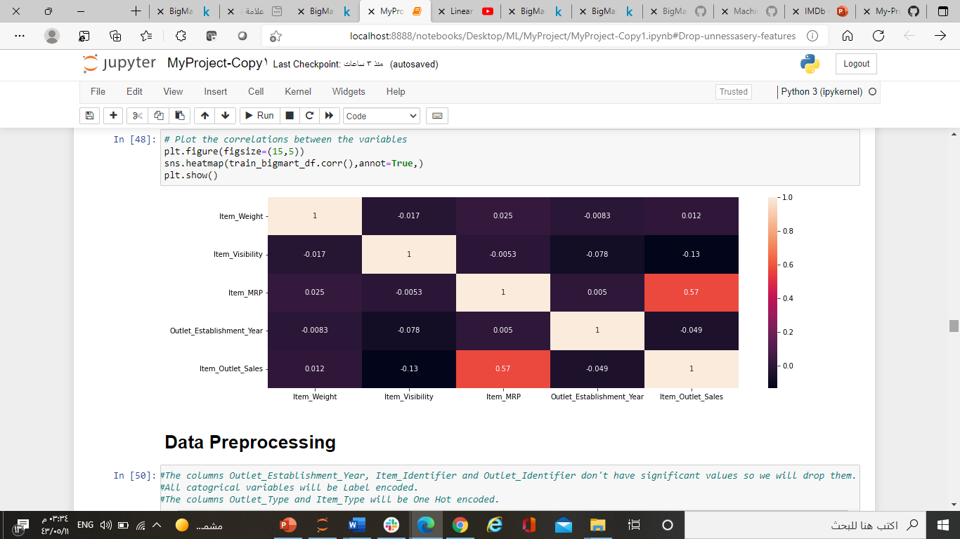
Heatmap Correlations

Slide 11
Before building my model, I do some future engineering.
- Label encoding on: Item_Fat_Content, Outlet_Size, and Outlet_Location_Type.
- One hot encoder on: Item_Type and Outlet_Type.
And I drop some columns:
- Item_Identifier, Outlet_Identifier ,Outlet_Establishment_Year, Outlet_Type, Item_Type.

Slide 12
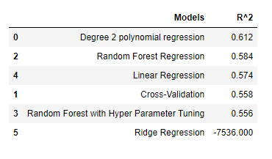
-I split my data to (80% for train / validation) / (20% for test ) I fit the models on train set ,and test on validation and test set.
- I used a Regression Supervised Machine Learning algorithms

Slide 13
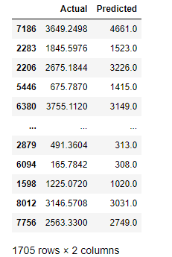
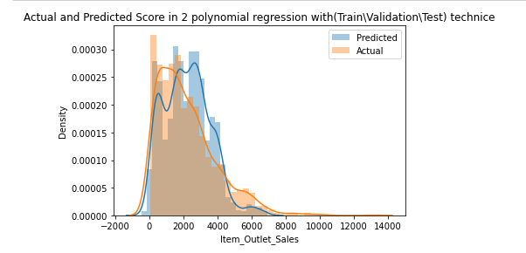
Show the difference between the Actual numbers and Predicted numbers

Slide 14
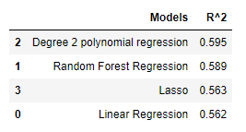
- I also try to train my model on data split (80% for train) / (20% for test).
- I fit the models on train set, and test on test set.

Slide 15
Thank You
Done by :
Tahani al shedoukhi

